Slide 1
DiaBuddy- A Diabetes Healthcare Assistant using LLM
by Team 31:
Vaibhav Vinay Ranashoor (50596107)
Rohan Jain (50608609)

Slide 2
Problem statement and motivation

Slide 3
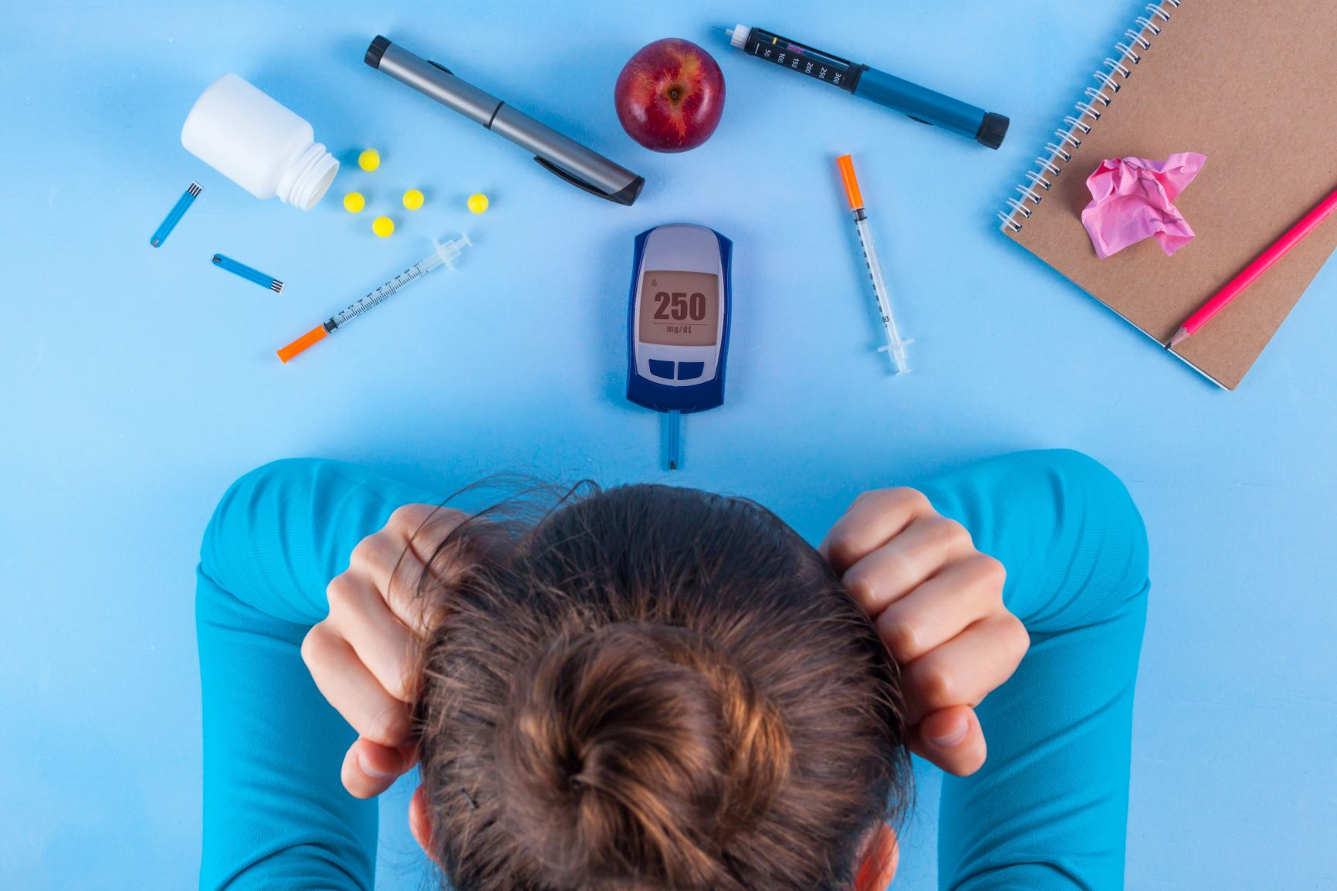
Problem Statement
Problem Landscape:
Diabetes: A chronic condition affecting ~10% of global population, creating an urgent need for accessible healthcare solutions.
Current chatbots (MedPaLM, HealthGPT) face challenges:
Hallucination of medical advice.
Lack of personalization.
Data privacy concerns when using cloud-based LLMs.

Slide 4
Introduction and motivation
Need for accurate, trustworthy, and lightweight diabetes assistants, especially for remote and resource-constrained regions.
More specifically: There is a need for a scalable method to deploy privacy-preserving diabetes assistants using open source Large Language Models on limited compute resources.
Our project addresses the critical need for accurate, trustworthy, and lightweight diabetes assistants, especially valuable for remote and resource-constrained regions where specialized healthcare infrastructure may be limited.

Slide 5
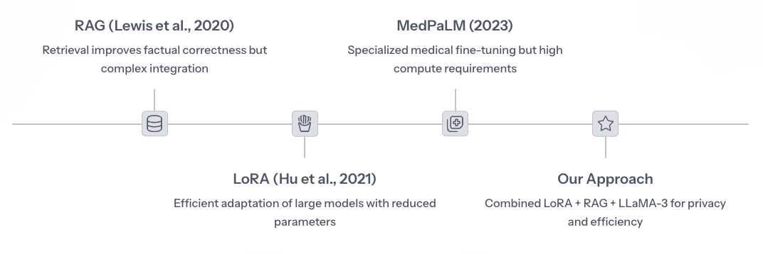
Related Works and Contributions
Our approach builds upon significant advances in medical AI while addressing key limitations in existing systems. We've examined specialized medical fine-tuning in MedPaLM, retrieval techniques from RAG papers, and efficient adaptation methods like LoRA.
Prior work has been limited by high inference costs and lack of open-source deployment examples in healthcare settings. Our contribution combines LoRA Fine-Tuning, RAG pipeline, and Open LLaMA-3 with a focus on privacy, lightweight deployment, and domain robustness.

Slide 6
Project Goal and Contributions
Objective:
Develop a deployable Diabetes Chatbot that balances accuracy, efficiency, and trustworthiness.
Major Contributions:
Creation of a curated, multi-topic Diabetes QA dataset.
Fine-tuning LLaMA-3 using parameter-efficient LoRA.
Building a RAG pipeline atop the fine-tuned model.
Detailed empirical comparison between Fine-tuning-only vs Fine-tuning+RAG setups.

Slide 7
Dataset characteristics

Slide 8
Dataset Characteristics
Dataset Source:
Self-curated based on trusted Q&A dataset released by medical professionals (for eg. MedQuAD,MedDialog)
Major Contributions:
Creation of a curated, multi-topic Diabetes QA dataset.
Fine-tuning LLaMA-3 using parameter-efficient LoRA.
Building a RAG pipeline atop the fine-tuned model.
Detailed empirical comparison between Fine-tuning-only vs Fine-tuning+RAG setups.

Slide 9
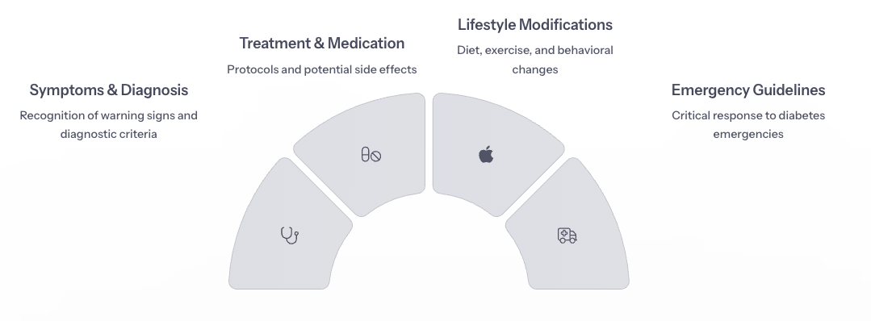
Categories Covered
Our project relies on a carefully curated dataset of 4,000+ question-answer pairs derived from trusted medical resources including the NIH and American Diabetes Association Guidelines. This self-curated approach ensures accuracy and relevance.
The dataset spans critical categories including symptoms, diagnosis, treatment protocols, lifestyle modifications, medication side-effects, and emergency guidelines. This comprehensive coverage allows our model to address the full spectrum of diabetes management needs.

Slide 10
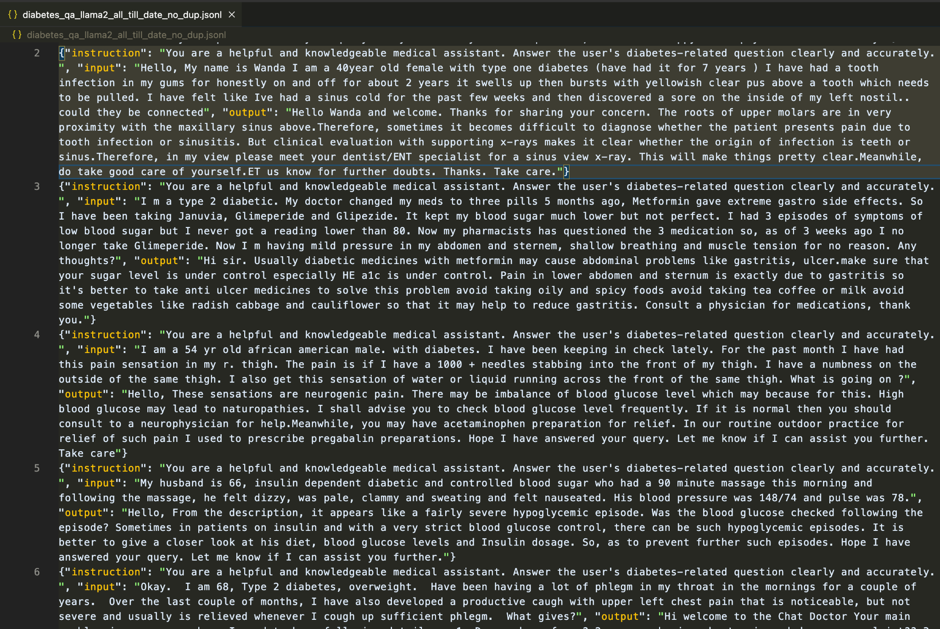
Dataset Screenshot (Total of 4277 rows!)

Slide 11
Technical Approach

Slide 12
Model Setup and Fine-Tuning
Base Model:
LLaMA-3 model (Instruct 8B version).
Fine-Tuning Method:
LoRA (Low-Rank Adaptation):
Frozen base weights.
Low-rank matrices trained (r=8, 6.8 million params fine tuned, ~0.08% of original parameters).
Compute Resources:
Nvidia’s A100 GPU in Google Colab Pro.

Slide 13
Why LLaMA-3 over DeepSeek R1
Initially considered DeepSeek R1 models due to their strong performance on multi-hop and reasoning tasks.
Issues encountered:
R1's larger model sizes (e.g., 6.7B) and complex architecture made it extremely slow to fine-tune on Colab Pro.
Even with A100 GPU, gradient checkpointing and quantization still caused runtime instability.
Alternate DeepSeek models (1.3B, Chat variants) lacked the instruction-following quality and factuality observed in LLaMA-3-8B-Instruct model.
Finally, we switched to LLaMA-3-8B-Instruct, which:
Had better zero-shot alignment than DeepSeek chat models
Was easier to fine-tune with LoRA
Required fewer memory optimizations and works well with Nvidia’s A100 GPU.

Slide 14
Retrieval-Augmented Generation Setup
Retriever Component:
FAISS Index: Dense vector store (~384D vectors from MiniLM).
Encoder Model for Embeddings:
Sentence Transformers: all-MiniLM-L6-v2
RAG Pipeline:
Encode user query.
Retrieve Top-4 most relevant chunks of text from a 2000+ page merged pdf.
Concatenate retrieved context with query.
Pass to fine-tuned LLaMA-3 for generation.

Slide 15
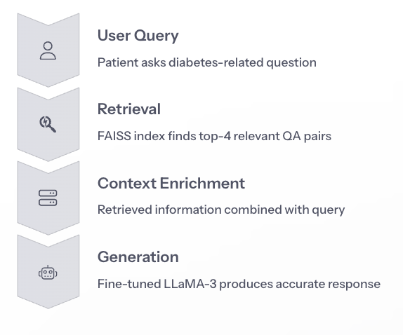
Retrieval-Augmented Generation Setup

Slide 16
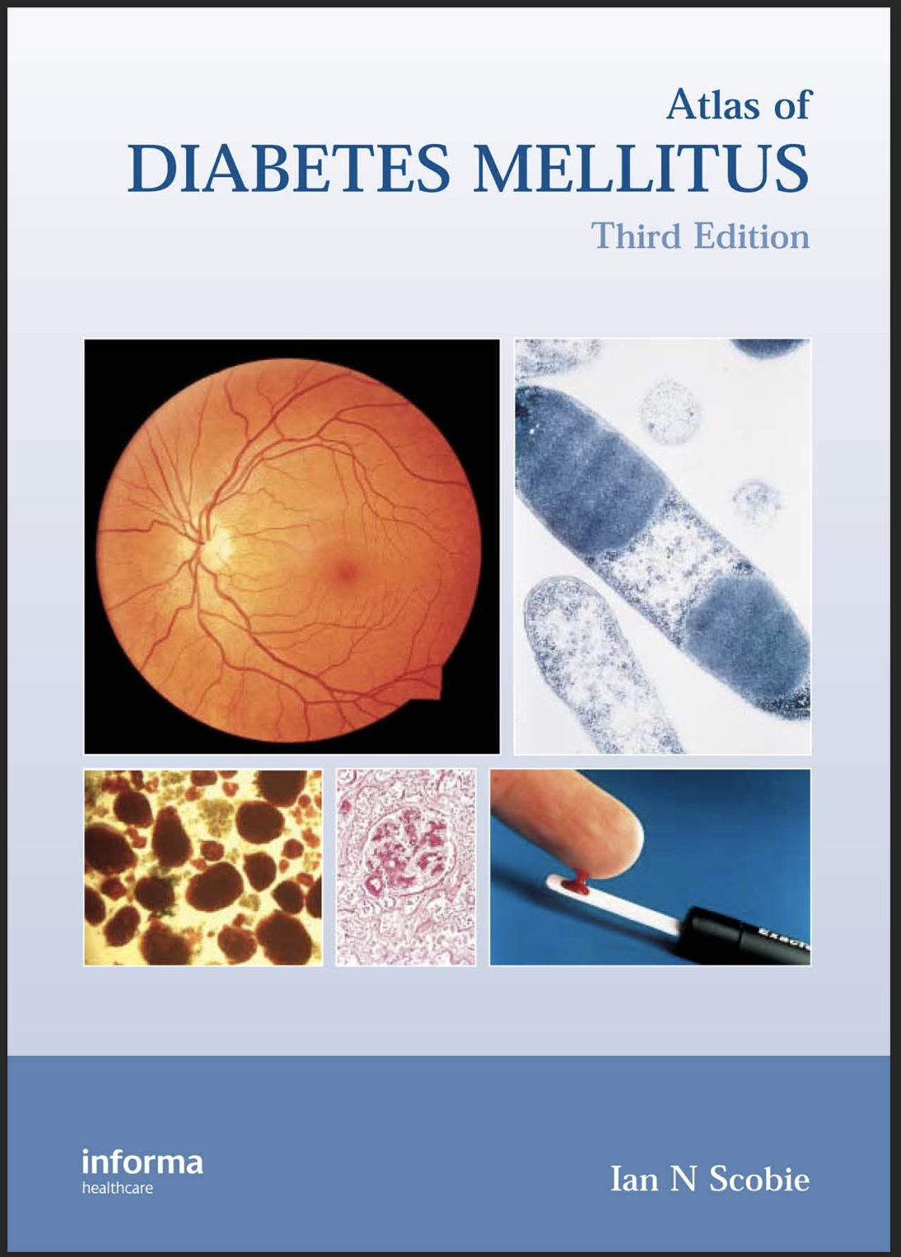





Data Sources for Retrieval Augmented Generation

Slide 17
Evaluation

Slide 18
Baselines for Comparison
Base Model:
LLaMA-3 model (Instruct 8B version).
Only Fine-Tuned Model:
Fine-Tuned LLaMA-3 without Retrieval (only supervised fine tuning).
Final Model:
Fine-Tuned LLaMA-3 + RAG (retrieval-augmented generation).

Slide 19
Evaluation Metrics
BLEU Score:
n-gram overlap → measures fluency similarity.
ROUGE-L Score:
emphasizes longest common subsequences
BERTScore:
Embedding similarity between generated and true answers.
Cosine Similarity:
Overall semantic proximity.

Slide 20
Evaluation Metrics
Hallucination Count:
BART-MNLI-based classification:
Entailment = Correct
Neutral = Uncertain (Neither contradictory nor entailing)
Contradiction = Hallucination
Note that we will consider only contradictions as hallucinations
t-SNE:
2D embedding visualization to evaluate representation quality.

Slide 21
Quantitative Results
Metric | Fine-Tuned Only | Fine-Tuned + RAG
BLEU | 0.81% | 0.78%
ROUGE-L | 6.86% | 6.97%
BERTScore | 83.44% | 85.29%
Cosine Similarity | 0.78 | 0.84
Hallucination Rate (contradictions) | 4% | 2%

Slide 22
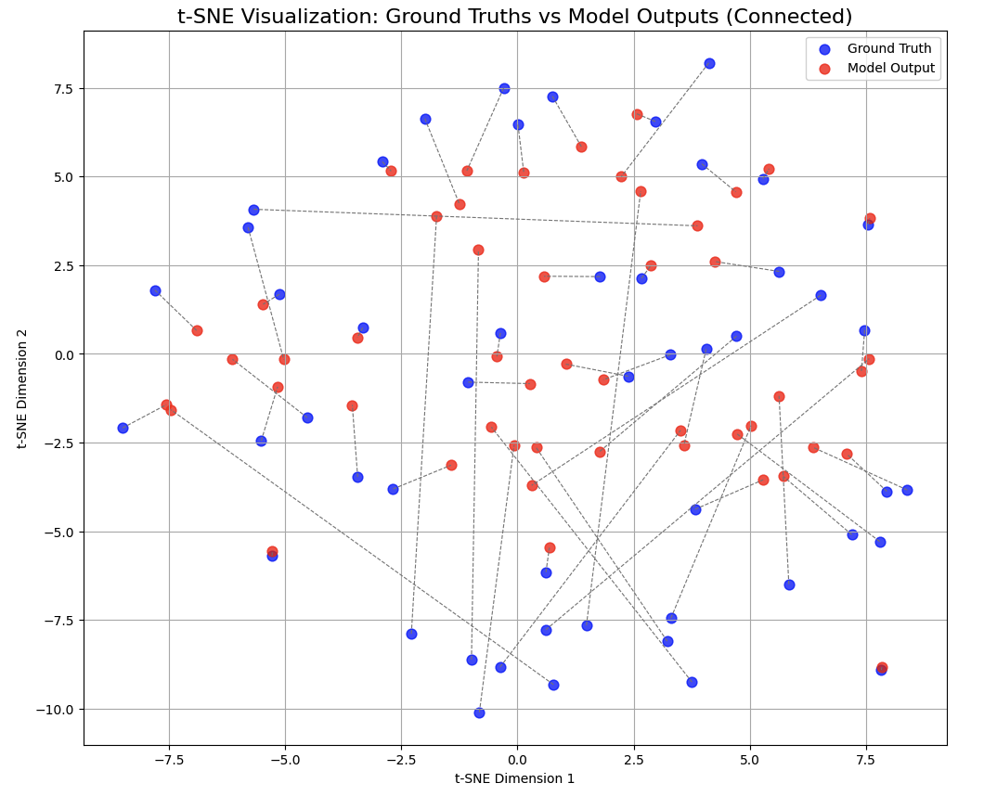
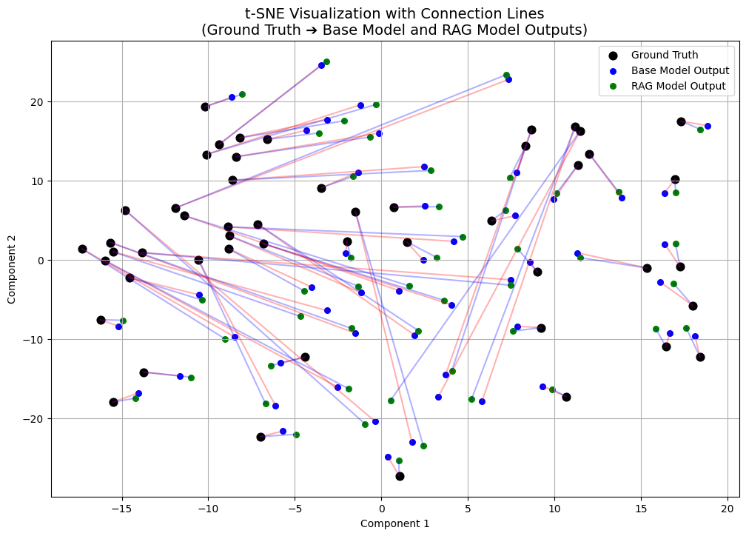
Quantitative results (T-SNE plots for base vs fine-tuned vs fine-tuned + RAG)

Slide 23
Error Analysis
Error Categories Observed:
Base Model: Very generic response, more hallucinated treatment suggestions
Fine-tuned model: more specific responses but only marginal improvement over base model
Fine-tuned + RAG: Some irrelevant retrievals (for k > 10) but minimal to none contradictions.

Slide 24
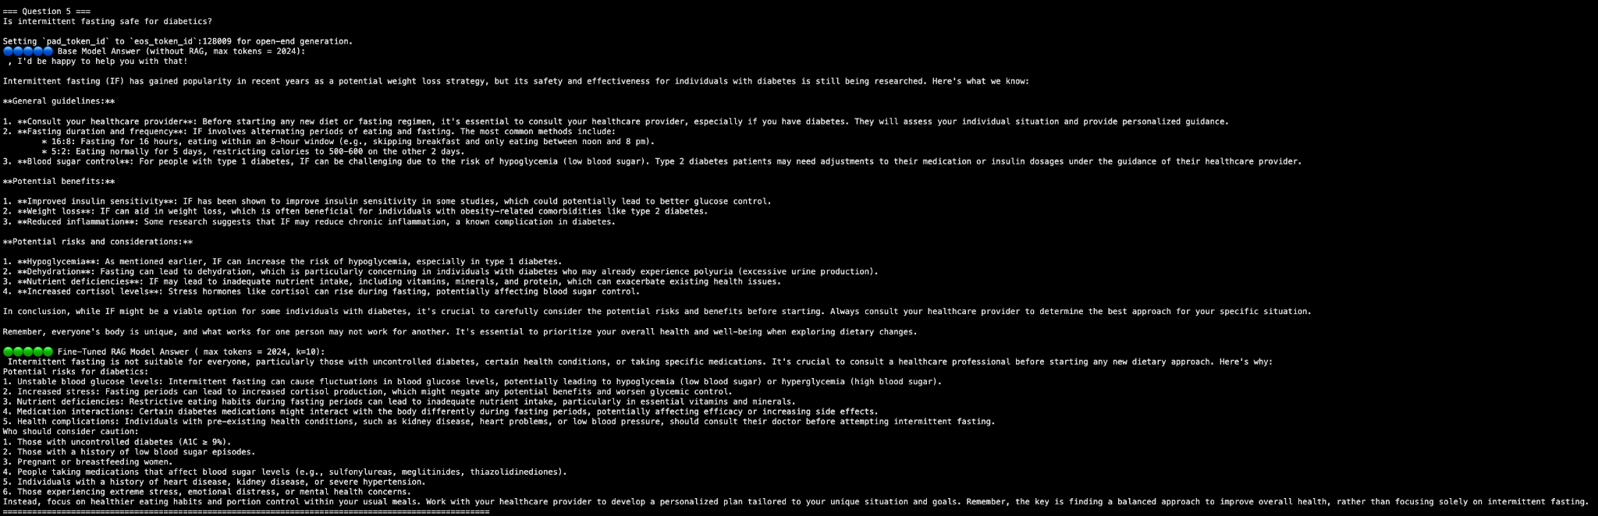
Case Study on how FT+RAG gives better response for a query

Slide 25
Conclusion

Slide 26
Conclusion
In this project, we built a lightweight, privacy-preserving, and clinically robust diabetes health assistant using open-source LLaMA-3, LoRA fine-tuning, and RAG—on just a single A100 GPU via Google Colab.
We achieved accurate, context-sensitive responses without relying on proprietary APIs or large-scale compute clusters.

Slide 27
Key Findings
Compute vs Capability Trade-Off
High-performing LLMs demand high compute. Efficient deployment in medicine needs optimization of cost-performance trade-offs at every step.
Data + Prompting Synergy
Curated diabetes QA pairs + structured prompting led to significant boosts in factuality and alignment.
"Curated data + precise prompts ⇒ superior LLM performance"
Descriptive Ground Truth = Better Generation
Detailed training answers consistently produced nuanced, clinically coherent responses.
Personalization is Dataset-Driven
Annotated datasets (ethnicity, age, religion) enabled seamless, hyper-personalized outputs—without retraining the model architecture.

Slide 28
Future Work
Enhancements Planned:
Add demographics-specific tuning (age, ethnicity factors).
Integration with real-time glucose monitoring APIs.
Deployment on smartphones using ONNX export, after model distillation and quantization.
Research Directions:
Better retriever fine-tuning.
Exploring contrastive alignment loss for RAG responses.

Slide 29
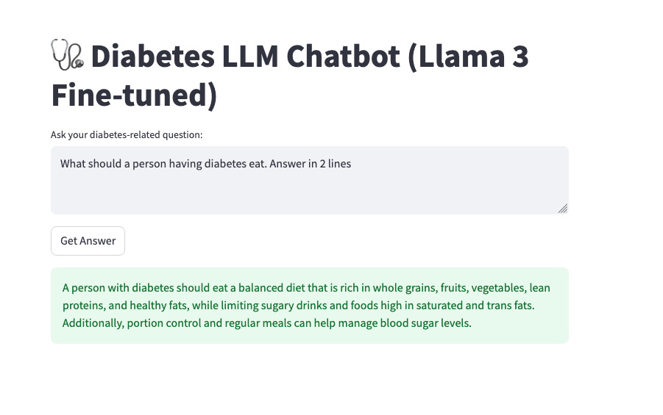
Screenshots of the app

Slide 30
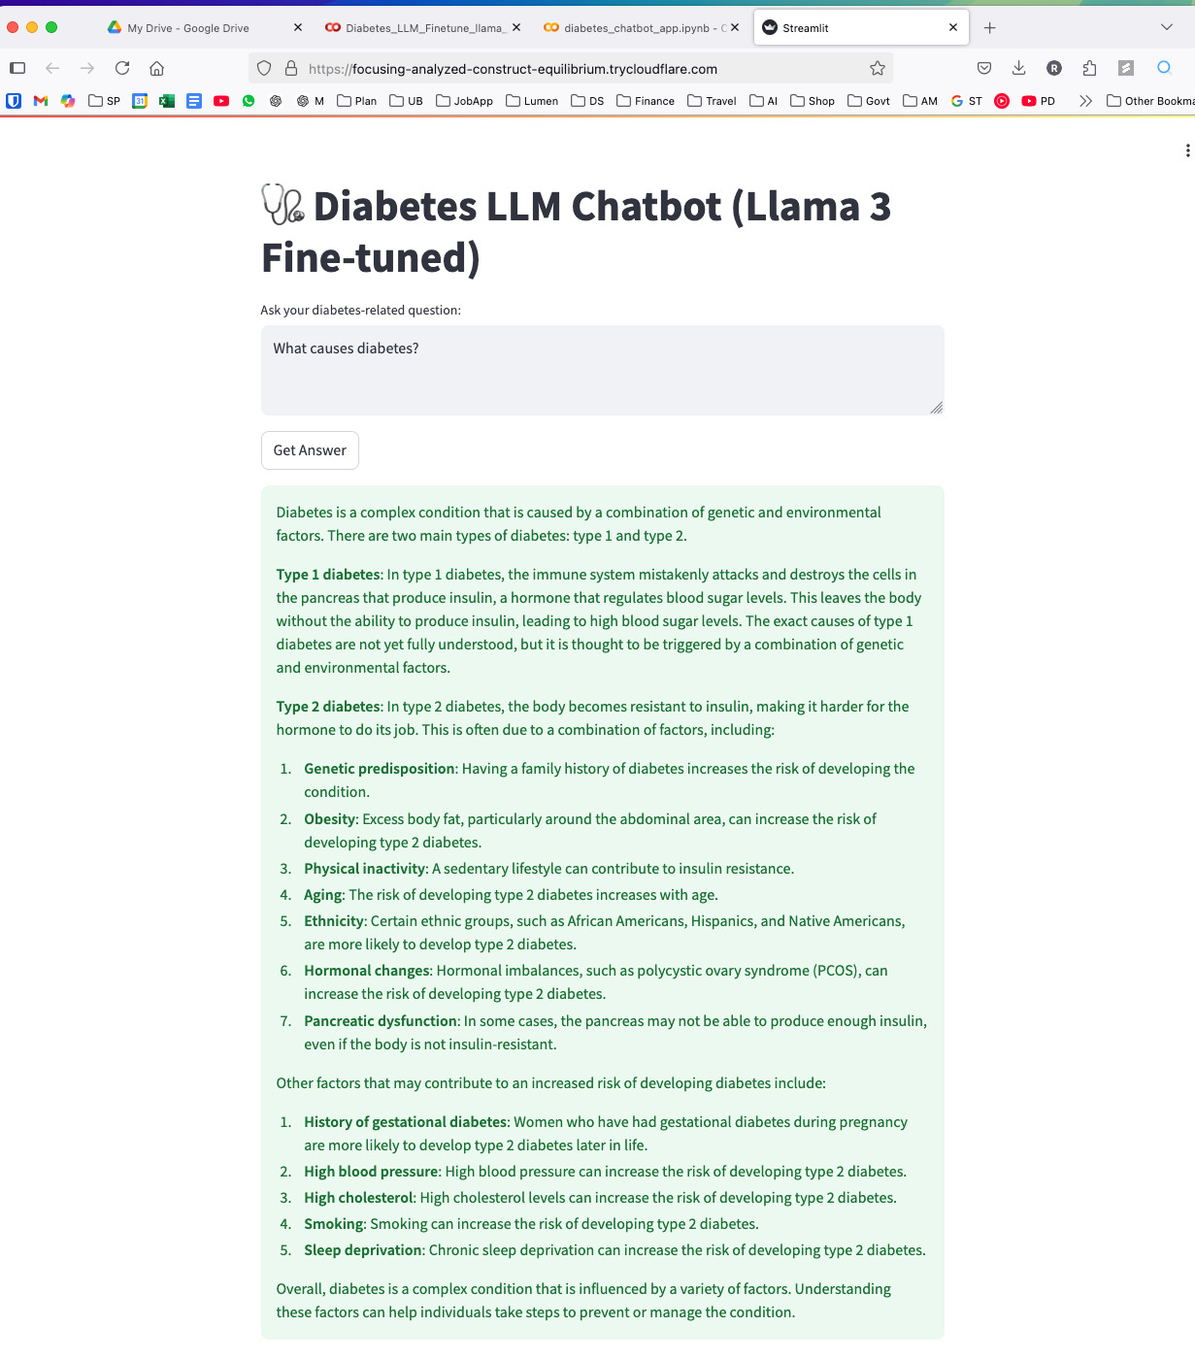
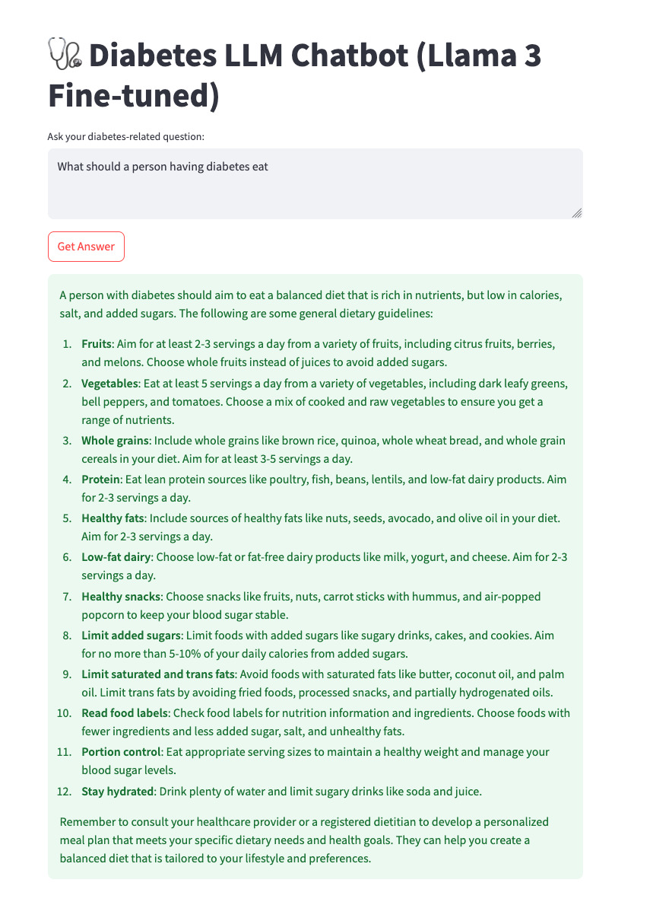
Screenshots of the app

Slide 31
Thank you!
Questions and feedback are welcome!

